Slide 1
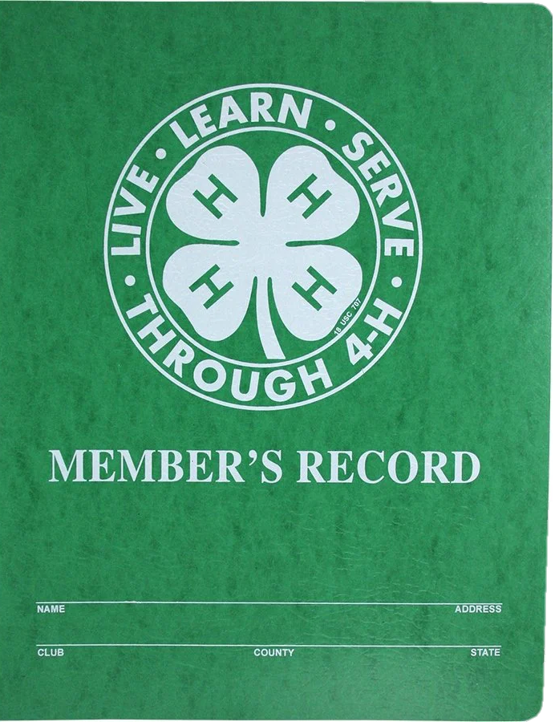


4-H Record Book Training
2021-2022
Presented by:
Adam Lesser
4-H & Youth Development Agent
alesser@ksu.edu  620-662-2371

Slide 2
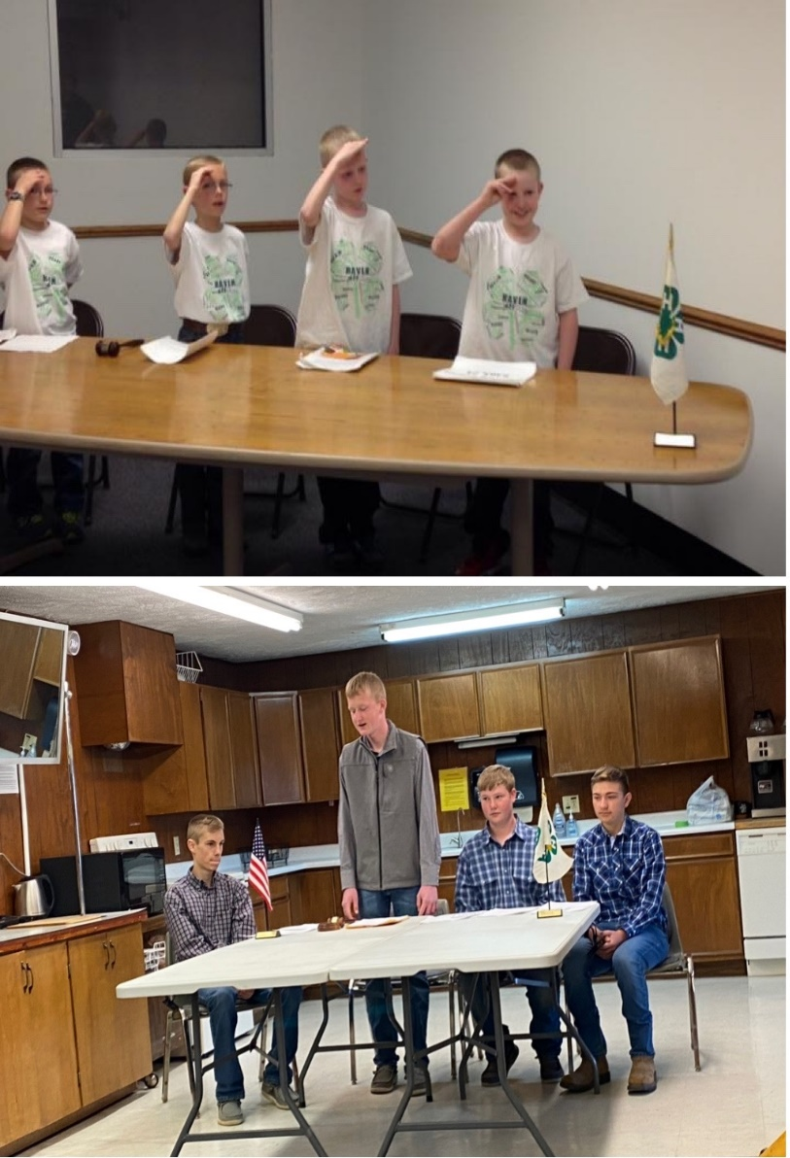
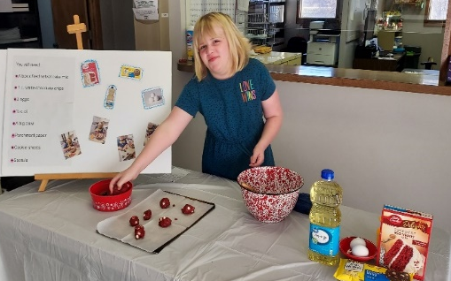
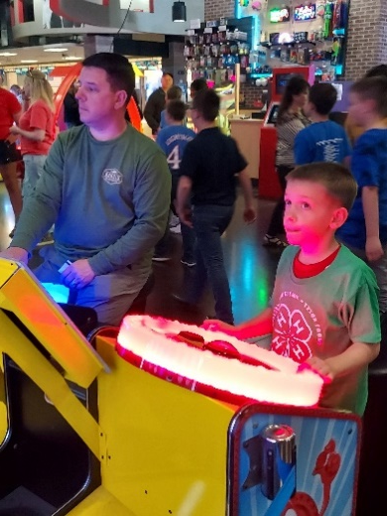
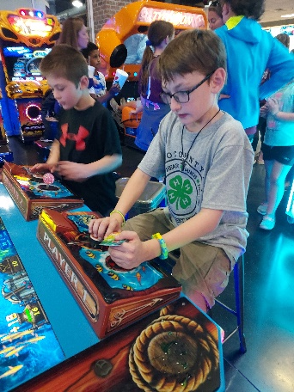
Why Record Books?
Part of a Project
Learn Life Skills
Teaches how to set goals
Earn Recognition!
Hold Memories for the Future
Notes:
To teach how to set goals
To make plans for action
Evaluate – how well you did
To learn record keeping skills
To learn to communicate, prioritize, and summarize what you did
To practice responsibility
To evaluate and prioritize information
To allow 4-H members to tell how they have grown, learned within outline parameters
Competition

Slide 3
What makes up a Record Book?
In the Green Folder…
Record Book Check Sheet (available at https://www.reno.k-state.edu/4-h/record_books/index.html)
Personal Information Page
Kansas 4-H Project Reports (1 report per project)
Your 4-H Story
Kansas 4-H Permanent Record
Notes:
The 4-H story is exclusive to Reno County
Regional and State record books will have different requirements, but are not the focus of this presentation

Slide 4
Getting Started
3 ways to complete your records
Use fillable PDFs from the county webpage
Use the Zbooks program
Written by hand
Notes:
Historically, most Reno county members have used the fillable PDFs.
Zbooks are highly recommended by the state

Slide 5
Important Information
Due Date: October 7th, 2022
Young members (7 – 8 years old) may use pencil
  All other members must use ink for any handwritten entries
It is okay to have a blend of handwritten and computer records, but try to keep individual sections consistent
One record book is turned in for each member
Notes:
Record books must be turned in my October 7th to ______________-
Young members are not required to write in pencil, they can still use the PDFs or Zbooks as well.

Slide 6
Constructing the Record Book
Record Book Check Sheet (available at https://www.reno.k-state.edu/4-h/record_books/index.html)
Personal Information Page
Kansas 4-H Project Reports (1 report per project)
Your 4-H Story
Kansas 4-H Permanent Record
Notes:
Same as a couple slides ago, but the order your record book should be assembled, and the order we will address them in this presentation

Slide 7
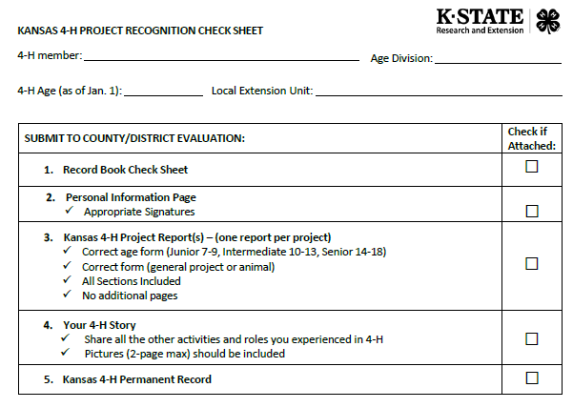
Record Book Check Sheet
Single page
Available through the county website
Used to verify all information is included
Qualified for Regionals or State? Make sure to use the check sheet on the second page!
Notes:
Check sheet was created only to help members and families stay organized and know they are on the right track. It helps us all make sure all of the necessary items are included.
When senior division youth qualify for regionals or state, this helps them make sure they have included those extra steps.

Slide 8
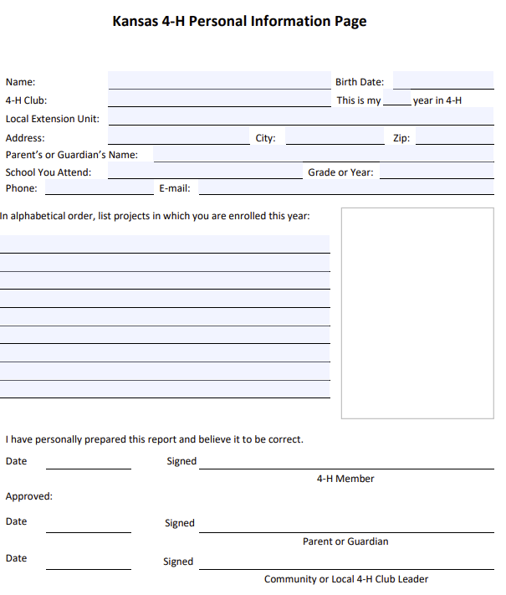
Personal Information Page
Contains personal contact information
Used to verify:
  Age Division
  Categories Entered
  Work is done by the youth member
This information is not judged
Notes:
Same as previous years, no changes
Used to verify information and provide a bit of background to the viewer

Slide 9
Kansas 4-H Project Reports (1 per project)
Make sure you select the
correct age form
  Junior 7 – 9
  Intermediate 10 – 13
  Senior 14 – 18
Choose between Animal or General Report Forms
Set font to Arial, size 10
Consists of…
  Project Goals
  Project Presentations
  Project Learning Experiences
  Project Exhibits
  Project Leadership Experiences
  Project Citizenship
  Project Financial Journal
  Project Reflection
  Project Photos
Notes:
Project reports should represent the work and thoughts of the 4-H member. Parents can help, but should refrain from rewording or completing the forms themselves.
All members are encouraged to complete at least one project report. Youth may complete one for every project if they would like.
Download these files from the county website, and save them to your computer first!
There is a limited number of items that you can input into these forms, so if you have more than is allowed, you will have to prioritize your items to include those that you deem most important. All forms have been set to Arial Size 10, so use concise language to complete your record in the space available.

Slide 10
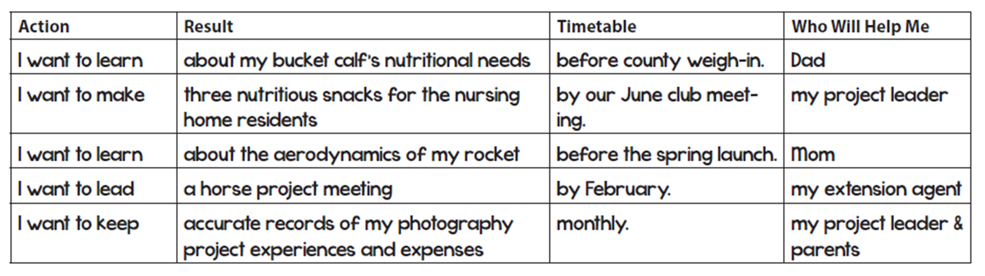
Project report form- Section 1: Goals
Notes:
Each age division’s form looks slightly different. The Intermediate forms seem to have the smallest space for the goal, since it still breaks it apart into smaller pieces.
Successful projects begin with written goals that provide a plan and a drive for the year.
Goals should be designed to provide learning within the project, develop technical skills, or provide leadership and citizenship to others.
A great way to make goals is with 3 steps:
Action – How are you going to do something
Result – What are you going to do. Be specific! (Avoid non-concrete phrases like “get better”)
Timeline – When are you going to do it?

Slide 11
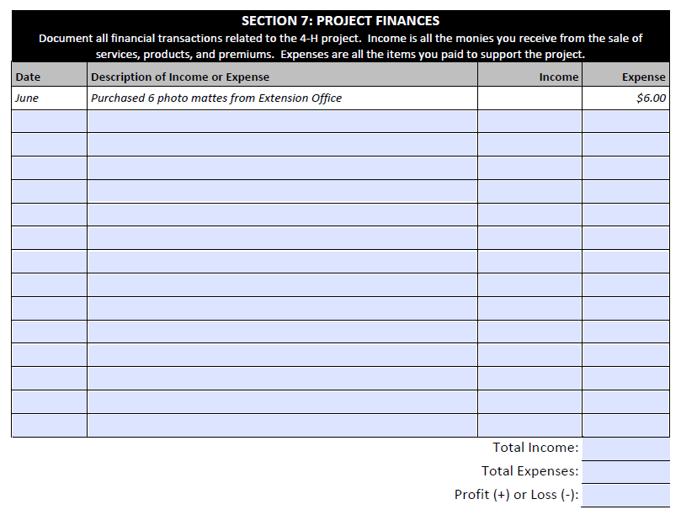
Section 7 – General Project Finances
General Project Report Form Finances
  Different than the animal form
Easiest to fill throughout the year, or by keeping receipts
Notes:
The focus is on accuracy and being thorough, not on profit or loss
It is not uncommon for a general project to have a loss
The goal is to help youth understand the price of different projects, and encourage them to look for opportunities to help offset that cost
Forms do not auto calculate on purpose, so that youth can learn how to determine that themselves.

Slide 12
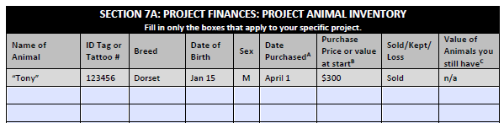
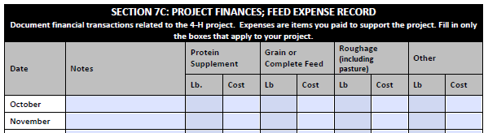
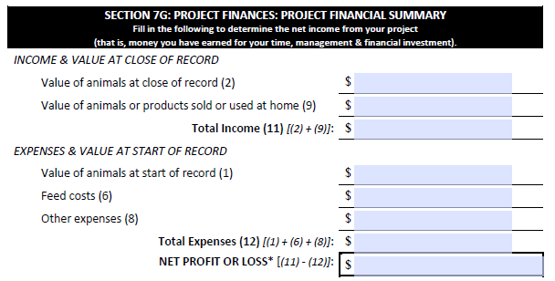
Section 7 – Animal
Project Finances
Different than the general project form
Not all financial charts will apply to all animals!
  Some are for Market Livestock
Notes:
The animal project report form has much more detailed finances.
Donated items can still be listed on this form, just describe that it was donated and put the cost as $0
The focus is on accuracy and being thorough, not on profit or loss
The goal is to help youth understand the price of different projects, and encourage them to look for opportunities to help offset that cost
Forms do not auto calculate on purpose, so that youth can learn how to determine that themselves.

Slide 13
Project Report Tips & FAQ
Levels of Participation for all sections
L - Local 4-H Club level
C/D - County or District Level
R - Regional level (more than one county/district)
S - State level
M - Multi-state level
N - National level
I - International level
Section 8 – Project Reflection
Different for each age group
  Ex: Junior form has questions to answer
Should focus on the specific project learning and experiences from this year
Suggested Outline:
  Introduction – Why this project?
  Body – Lessons learned?
  Conclusion – What’s next?
Notes:
The Project Reflection is similar to the 4-H story, but focused on one specific project instead
Should not just be a repetition of the project record. Expand upon those entries to “tell the story” of your project year.
Organize your writing by including the Introduction, Body, and Conclusion
Introduction – Catch the reader’s attention and set the stage for your year in the project
Body – Focus on what you did and how that helped you grow. It’s also great to include things that didn’t go well, especially when they helped you learn something important.
Conclusion – Tie it all together and consider including future impacts from the year. How does this affect your career goals? What about goals you want to pursue for next year?

Slide 14
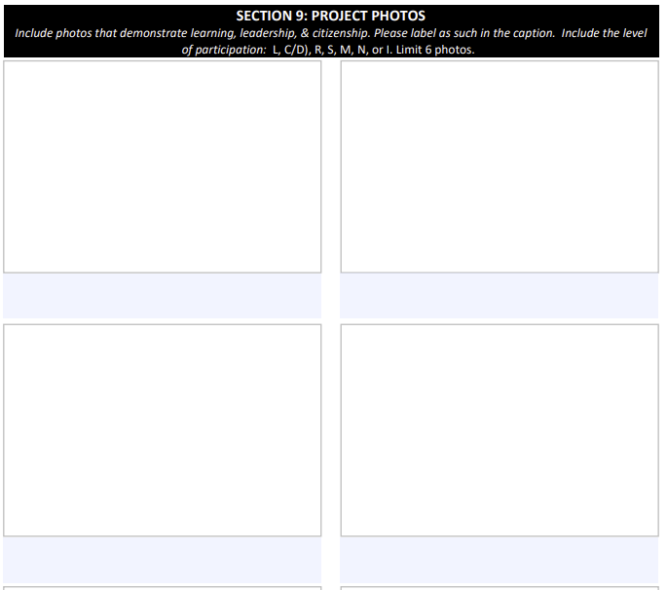
Project Report Tips & FAQ
Section 9 – Project Photos
All photos should include captions and the level of the event
Maximum photos by age division:
Junior – 6 total photos
Intermediate – 12 total photos;
  6 learning and 6 combined leadership & citizenship
Senior – 18 total photos;
  6 learning, 6 leadership, and 6 citizenship
Notes:
Again, each age group is different.
Be careful with each form, as they do include a label for each type of picture that should be included on the older divisions
Photos should show the member doing things, leaning and teaching others, and having fun within their project work.

Slide 15

Your 4-H Story
County Level Only
Contains a summary of your total 4-H experience and activities this year
Essay form
  Highlight your involvement, experiences, leadership, club work, community service, county activities, etc.
  Adds a better representation of your year than only project records
Max of 6 written pages (double spaced & Arial 10 font) and 3 pages of pictures
  Don’t forget the captions!
Notes:
Only included for the local level, not regional or state
No minimum requirement for photos or written pages.
Use a Word or Google Doc to create this

Slide 16
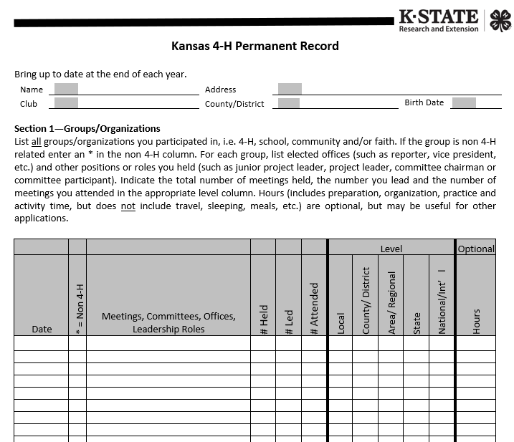
Kansas 4-H Permanent Record
The complete compilation of a member’s activities
  Include both 4-H and non-4-H related items!
Incredibly helpful for scholarship & award applications
Use the fillable Microsoft Word document from the website, or through Zbooks.
Notes:
This form should be kept and updated from year to year.
1st year members will have a few entries, 10 year members will have pages of entries
If you have a permanent record from before Oct. 2020, it may look slightly different. All the content is still the same, so you may use either version. You do NOT have to transfer the information into a new form.

Slide 17
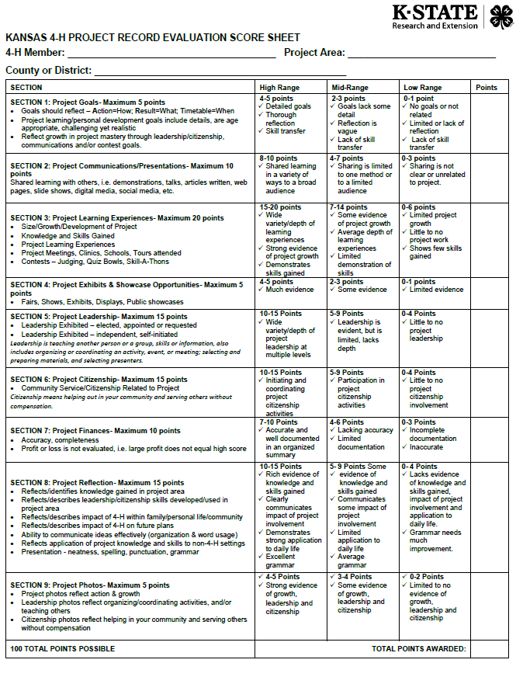
Qualifying for Regionals or State
Evaluations for the local unit can be found through https://www.reno.k-state.edu
Regionals or State Record Books do have additional requirements!
  Cover Letter
  Resume
  Project Award Video

Slide 18

Tips for the Future!
Don’t wait until the last minute!
Quality over Quantity
Take pictures throughout the year
Keep a journal or computer file that is easy to update as things happen
  Zbooks can help keep record throughout the year as well!
Projects are completed by the fair, so most of your record books can be done by then too!

Slide 19

Thank you!
Adam Lesser
Reno County 4-H & Youth Development Agent
alesser@ksu.edu
620-662-2371
www.reno.k-state.edu

